Slide 1
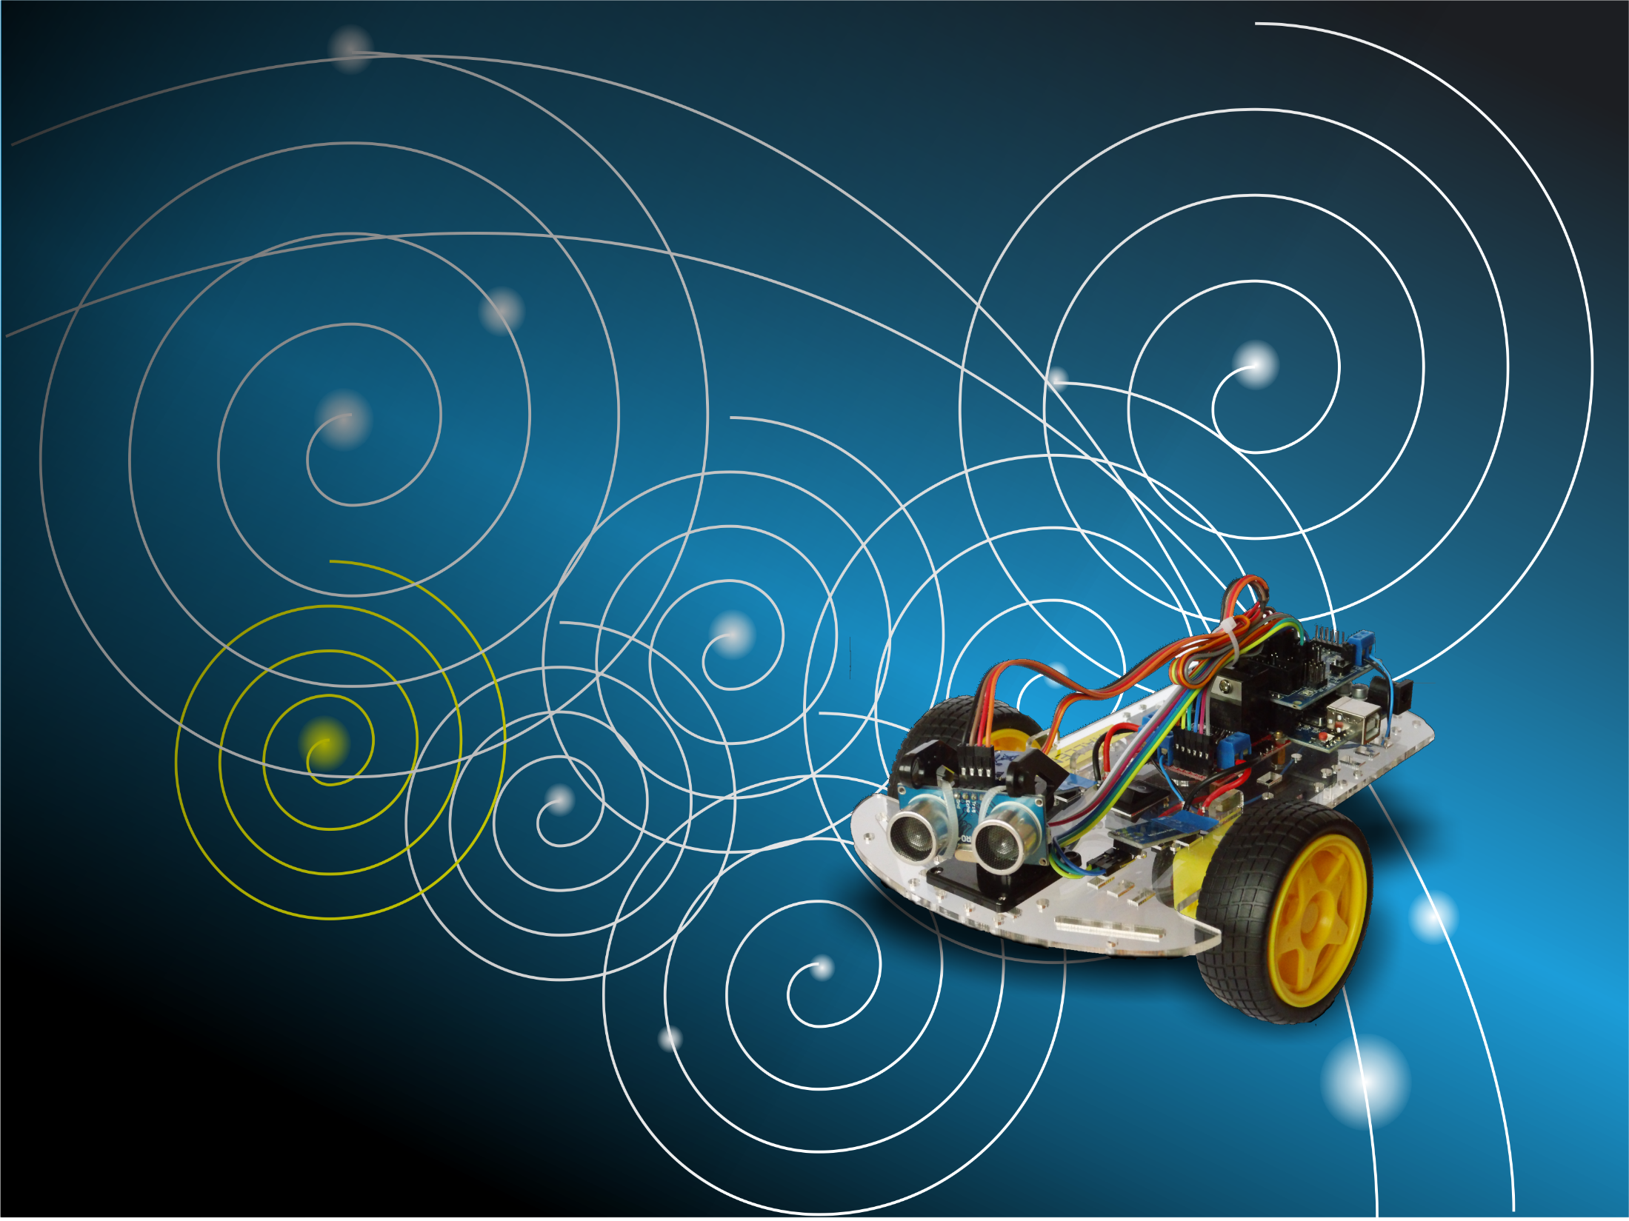
AUTONOMOUS ROBOT CHALLENGE
Building and programming your own robot
Notes:
Hello
Welcome and thank you for joining.

Slide 2

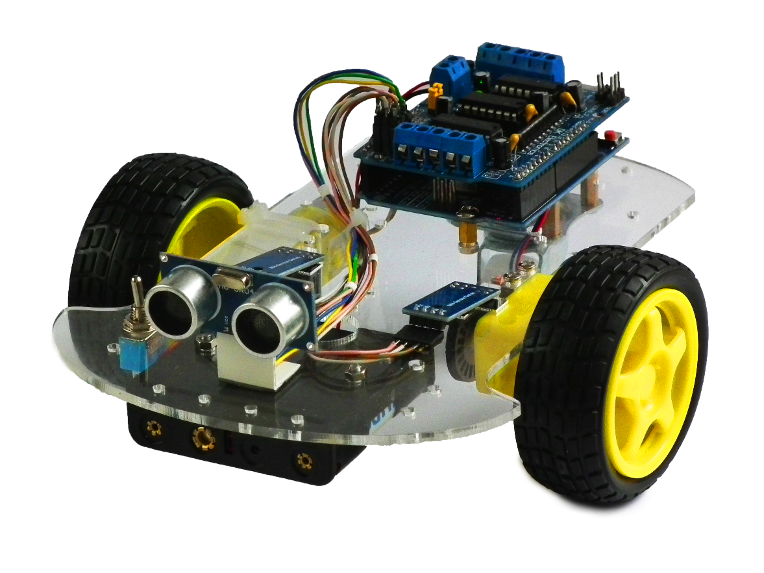
Not by IKEA
Notes:
Not by IKEA
IKEA
Not tested hundreds of times
Can not be assembled only the right way

Slide 3
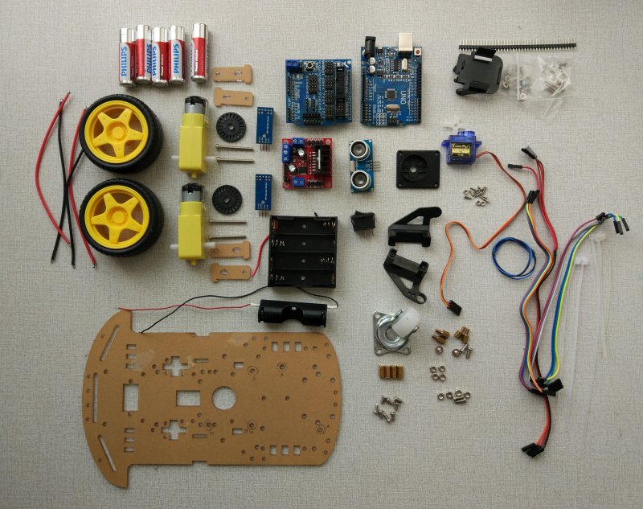
Robot Kit
Notes:
Robot Kit
Parts bought separately.
Some altered, some self-made.
Can be built in a multitude of wrong ways.
Construction requires screwing, soldering, tie wraps and insulation tape.
You are engineering, you have to make it work

Slide 4

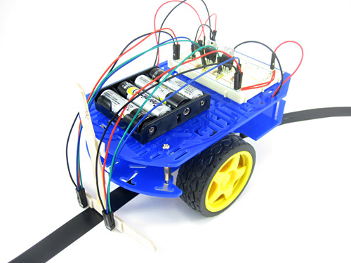
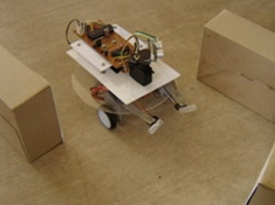
Why Homebuilt
Notes:
Why homebuilt
Available Kits:
Expensive
Exotics (walkers, spiders) left alone two types
Collision avoidance
Line following

Slide 5


Something more
Notes:
Something more
Ultrasonic distance sensor (also on collision avoidance)
“See”.
Know the distance to an object
Detect a wall
Detect an object
Speed sensor.
Calculate speed, distance and direction.
Move in a straight line.
Turn a certain angle.
Whatever you derive

Slide 6
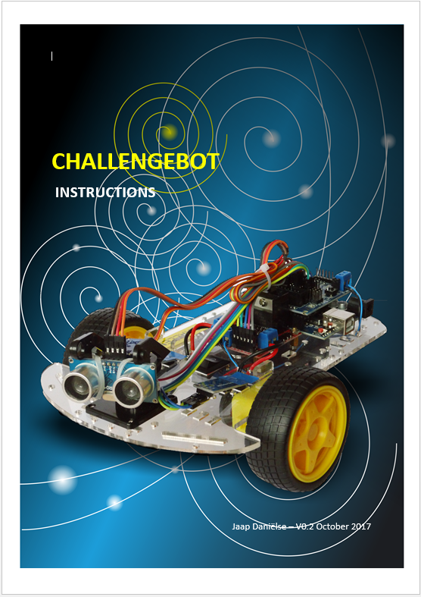
Instructions
Notes:
Instructions
Info in the instructions

Slide 7
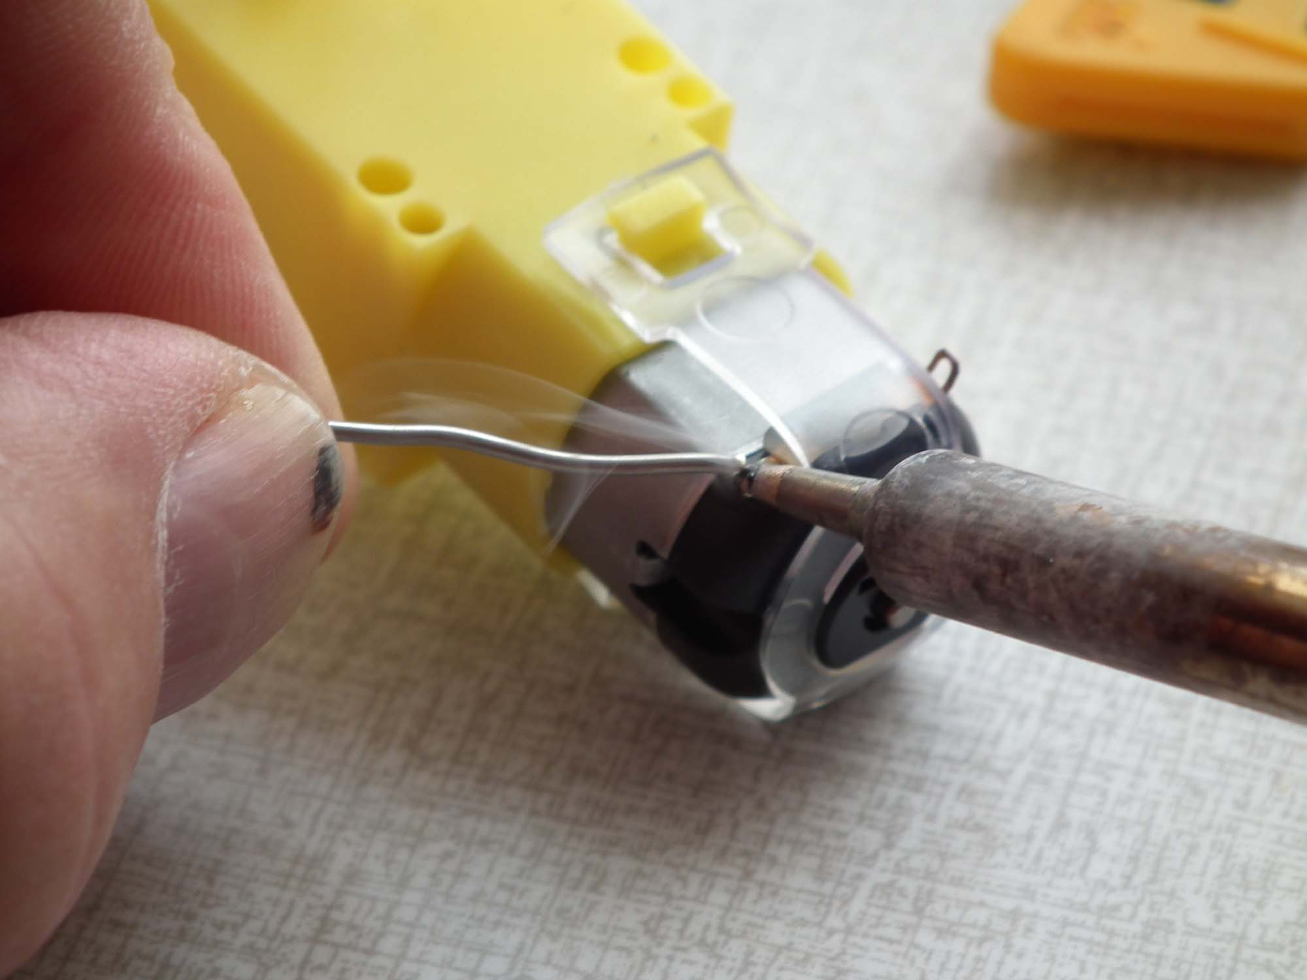
Soldering
Notes:
Soldering
Swiftly but hot enough to make the tin liquid.
Not too long to prevent plastic form melting (stop after 3-4 sec max to cool down first).
Motors, Switch, Battery leads.
Ask for help.

Slide 8
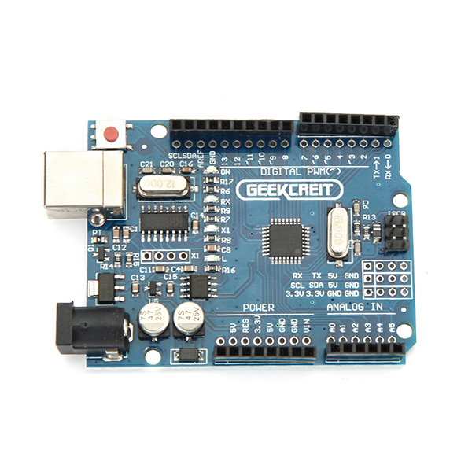
Arduino board
Notes:
Arduino board
Our main board.
Sits on top of two standoffs.
Hex / torx screws (screwdrivers available)

Slide 9
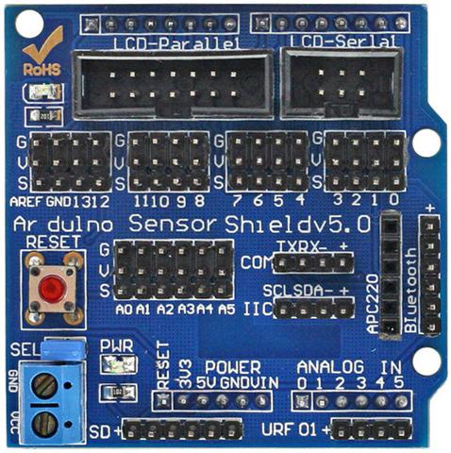
Sensor shield
Notes:
Sensor Shield
Passes sensor, and motor/servo control data.
Careful support the Arduino shield when mounting motor shield and fastening terminals.

Slide 10
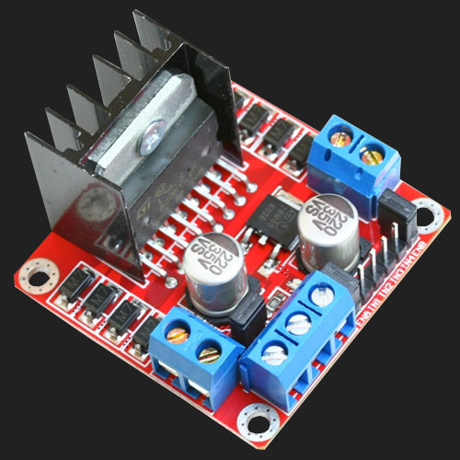
Motor Board
Notes:
Motor board
Drives the motors.
Provides current to the Sensorshield and Arduino board

Slide 11
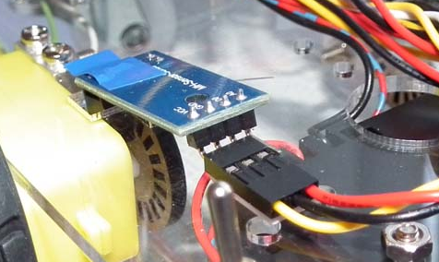
Speed Sensors
Notes:
Speed sensors
Index wheels with slots.
Infrared beam and sensor.
Slot gives signal to the Arduino.
Bending pins to accommodate position.
All slots in index wheel free.

Slide 12
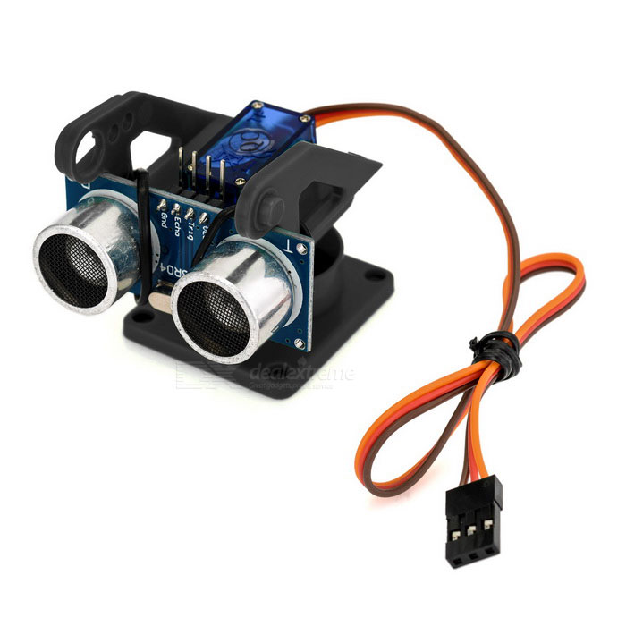
Distance Sensor/Servo
Notes:
Distance sensor and servo
A lot of small screws and nuts

Slide 13
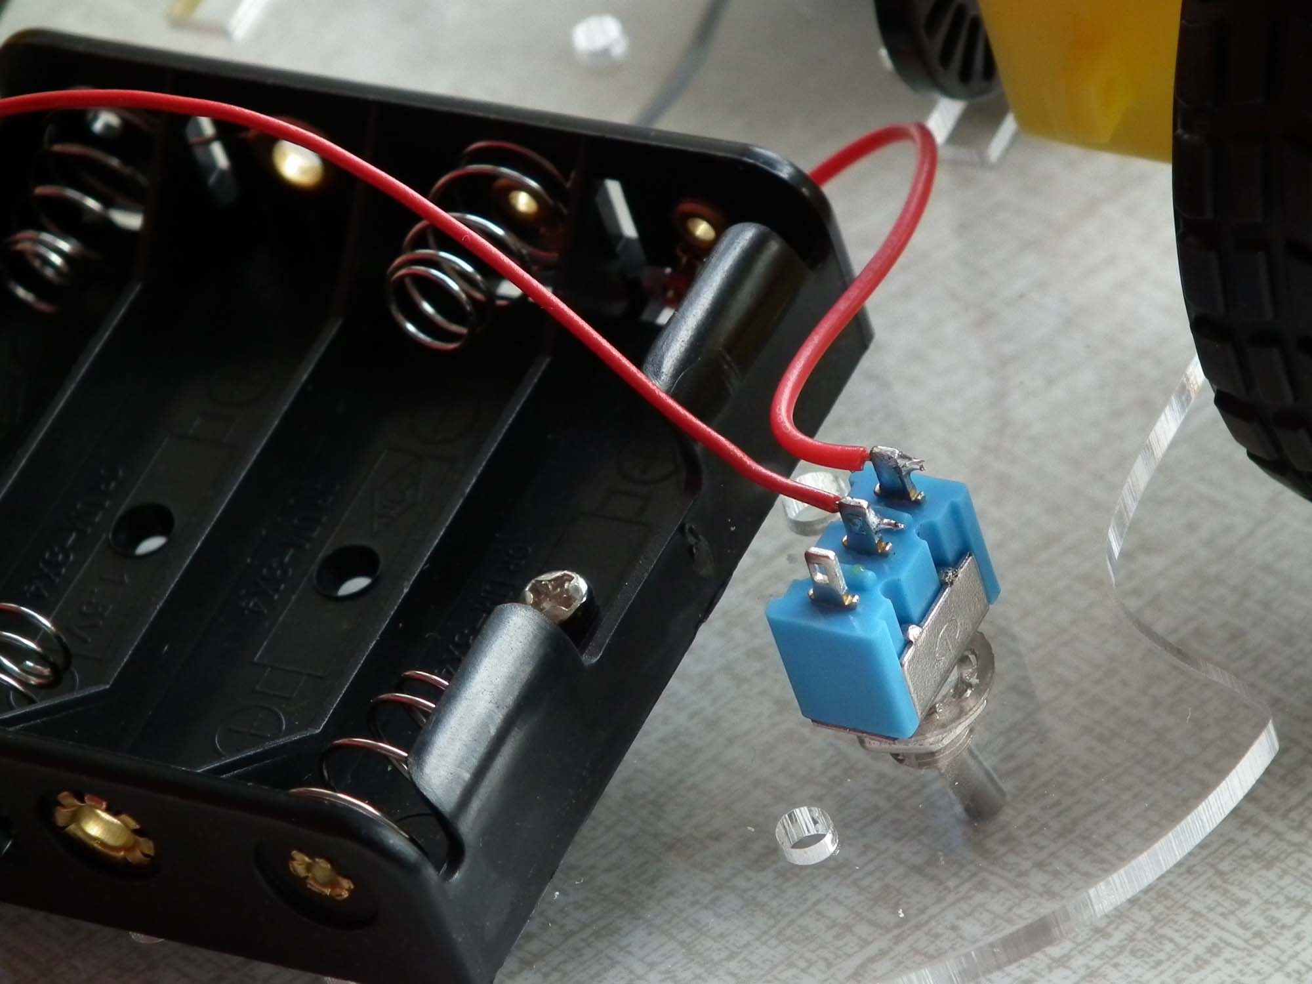
Battery case and Switch
Notes:
Battery case and switch
We need an extra battery case because the voltage will drop to low on just 4 batteries (6 volts)
So we put in 2 more (total 9 volts). The switch (a different one than this one) is soldered between the case wiring of both cases.
Don’t put the batteries in until ready and checked.

Slide 14
Testing
2
3
6
1
7
5
4
Notes:
Testing
Place batteries.
Switch on, LED’s (OK), no LED’s (switch off).
ChallengeBotTest sketch (program).
Program cannot see motor direction.

Slide 15
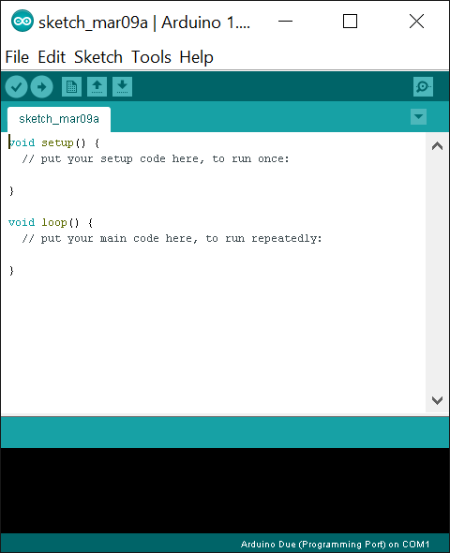
Arduino IDE
Notes:
Arduino IDE
Available for free.
Programming in C / C++.
Plugin available for Visual studio (both free)

Slide 16
Robot Hello World
BEHAVIOUR
BASIC COMMANDS
HARDWARE DRIVERS
Notes:
Robot Hello World
Three layers
Top layer, behavior.
Middle layer Basic commands: Drive straight, Turn, Stop
Bottom layer hardware drivers.

Slide 17
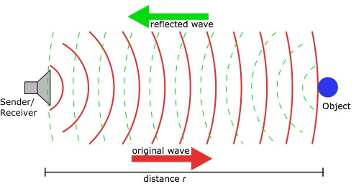
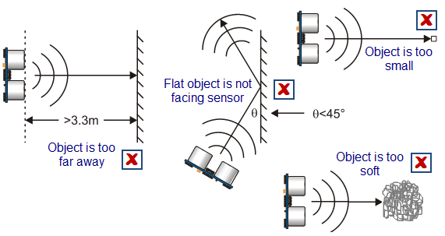
Measuring distance
Distance in cm = ({time to echo}/2)/29.14
In 29.14 μs sound travels 1 cm.
Pipe object visible at approx. 50 cm.
Vison angle ± 45°
Echo time #define ECHODELAY 30 //
Notes:
Measuring Distance
Real world problems
View angle (45) degrees
Sound reflection up to 45 degrees
Object visible till approx. 50 cm.
Echo time #define ECHODELAY 30 //

Slide 18
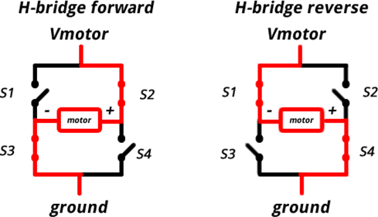
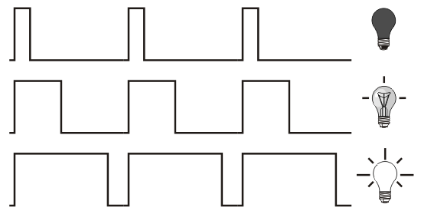
Motor control
H-Bridge (forward / reverse)
PWM (Pulse Width Modulation)
(0 – 255)
Notes:
Motor control
H-Bridge (forward / reverse)
PWM (Pulse Width Modulation) (0 – 255)

Slide 19
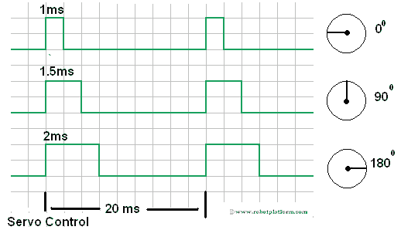
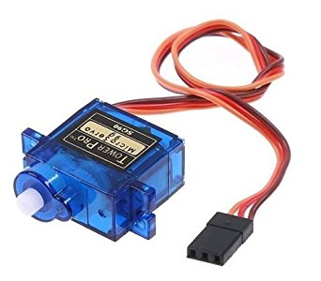
Servo control
PWM Used for position
(not speed)
Init with values for 0°, 90°, 180°
Get values from ChallengeBotTest
Notes:
Servo control: pwm value converts to position.
Formal between 1 ms and 2 ms but actual values may differ.
We use hardware pwm.

Slide 20
Drive
// Motor PWM Slow (get values from ChallengeBotTest)
#define SLOWPWM 80 // PWM value for slow drive
// Motor PWM Fast
#define FASTPWM 255 // PWM value for fast drive ( max pwm=255 )
Notes:
Drive
Controls speed and direction by switching off a fast motor
// Motor PWM Slow
#define SLOWPWM 80 // PWM value for slow drive (experiment with setting for your robot)
// Motor PWM Fast
#define FASTPWM 255 // PWM value for fast drive ( max pwm )

Slide 21
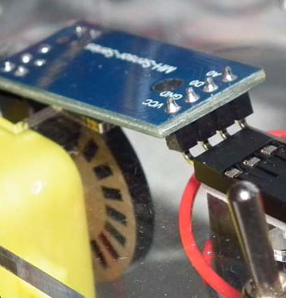
Interrupt callback
Main
program
!
Interrupt service routine
Drive
Callback routine
Notes:
Interrupt callback
Speed sensor interrupt
Via callback to drive to controls speed and direction.
Extend drive with a scan function.
Don’t make it too long! Interrupt cascading, do analysis outside ISR.

Slide 22
Behaviour
Notes:
Behaviour
Drive 700 mm. fast
Drive 300 mm. slow
Scan for object if found within 30 cm “look at it”
Turn 180
Repeat
Object closer than 20 cm slow
Object closer than 5 cm stop (and wait)
Object gone: resume

Slide 23
Challenge
Notes:
Challenge
Square field.
A number of targets to knock over.
No touching the walls.
More details when planning.
Work in teams.

Slide 24
Have Fun! (don’t rush)
Notes:
Have fun!
(don’t rush!)

